Slide 1
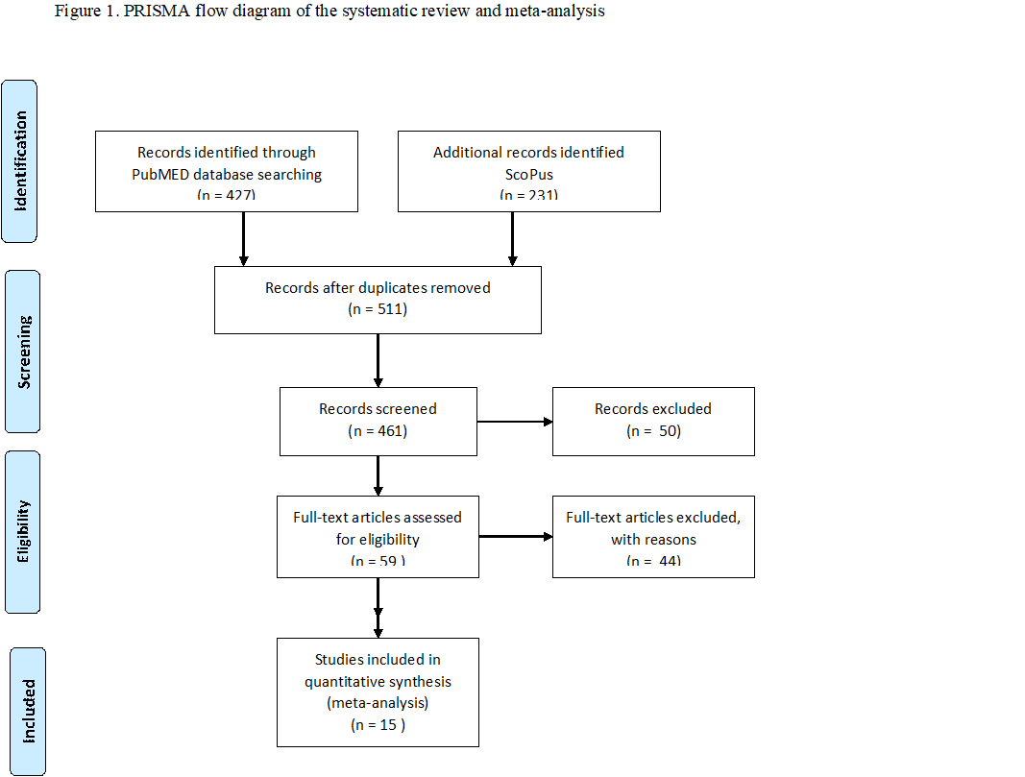

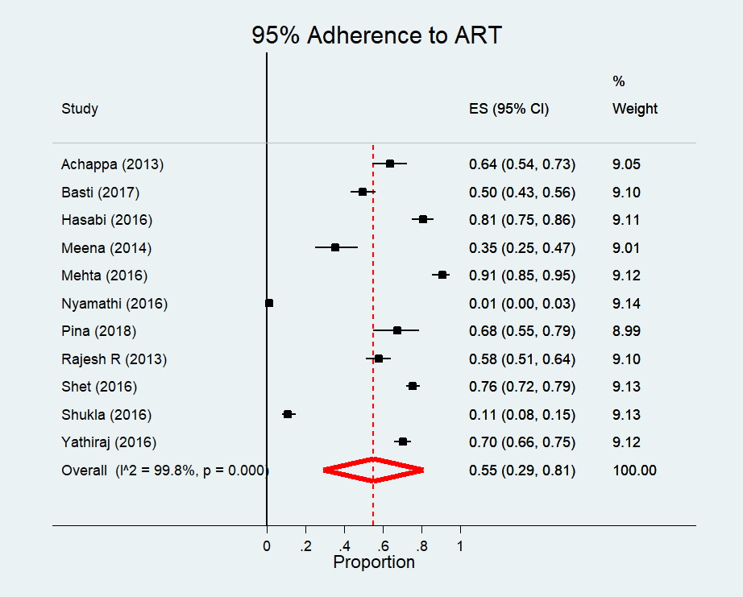
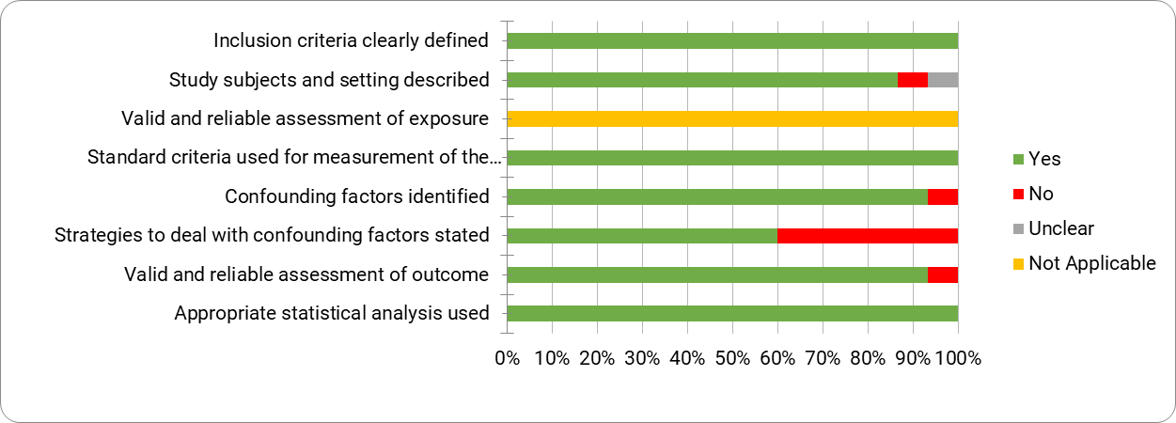

Anti-Retroviral Therapy Adherence in India (2012-18): A systematic review and meta-analysis
Saurav Basu1, Yamini M1, Suneela Garg1, Bala Ganesh2
Dept. of Community Medicine, New Delhi, India; Indian Council of Medical Research – National Institute of Epidemiology
INTRODUCTION
It is well-established that a high rate of adherence (95%-100%) to ART is required to achieve and maintain viral suppression in the PLHIV [1].
Failure to maintain adherence to ART is causally associated with the progression of HIV to AIDS, increased risk of opportunistic infections, and mortality with lowering of quality of life [2] .
ART nonadherence substantially increases the risk of resistance to second-line ART that requires switching to third-line ART associated with increased toxicity and healthcare costs.
The National Aids Control Program launched phase IV of the program (NACP IV) in 2012 inclusive of a dedicated component towards expansion of care, support and treatment services for promotion of greater adherence and compliance, especially in at-risk groups like women and children
OBJECTIVE: to ascertain the extent of ART adherence and reasons for nonadherence among PLHIV in India.
METHODS
Search strategy and selection criteria
This systematic review was registered in PROSPERO (CRD42018104450). We searched PubMed/MEDLine and Scopus for studies conducted between Jan 2012 and June 2018 and published in the English language. We excluded retrospective studies with the entire data collected before 2012
A combination of the following text keywords and MeSH terms: “Medication Adherence,” “Patient Compliance,” “anti-retroviral therapy,” “Antiretroviral Therapy, Highly Active,” “HIV,” “AIDS” and “India” was applied.
Statistical analysis
The extracted data was single entered in EpiData software version 3.1 (EpiData Association Odense, Denmark) and data analysis was done using Stata statistical software version 14 (StataCorp LP. College Station, TX). Meta-analysis was conducted using the “Metaprop_one” function in STATA. Chi square test for heterogeneity was done and the p value was <0.001 with an I² statistic of 99%. Since there was significant heterogeneity between the studies, random effects model was used to calculate the pooled estimates for measuring adherence to ART. The pooled estimate was expressed as proportions with 95% confidence intervals.
RESULTS
Characteristics of included studies
The mean (SD) effective sample size of the studies was 215 (160). The mean (SD) age of the participants in the included studies was 34.4 (10.1).
All studies were urban facility-based except one rural community-based study
Geographic location: Northern India (2); Western India (1); Eastern India (1); Southern India (11)
Adult participants (14); Pediatric (1); MSM (1)
Study design: Cross-sectional (8); Prospective (3); Intervention (2); Qualitative (1)
Adherence measure: Pill count (6); Self-Report (8); Visual Analogue Scale (2)
Period of recall: 30 days (8); 90 days (2); 4 days (2); 14 days (1); not reported (2)
ART Adherence
The pooled prevalence of ART adherence as per ≥95% adherence criterion was 0.54 (95% CI: 0.27-0.81) (Figure 2).
On combining the Pina study (2018 [3] that only reported 100% adherence, the adherence rate was 0.55 (95% CI: 0.29-0.81) (Figure 3)
Among facility based studies, the ≥95% adherence rate was significant higher 0.62 (95% CI 0.46-0.78).
In the rural community-based study among female PLHIV by Nyamathi et al (2016) only 4 out of 400 participants reported ≥90% ART adherence rate [4].
Predictors of ART Non-Adherence
Forgetfulness (8/15)
Running out of pills (3/15)
Distance from the health center (2/15)
Alcohol abuse (3/15)
Concealment of HIV status from family (2/15
Felt stigma (2/15)
Depressive symptoms (2/15
Fear of side-effects (2/15).
Methodological quality
The quality of the studies was appropriate except in dealing with confounding factors (60%).
Most studies did not assess for the social desirability bias (Figure 4)
DISCUSSION
The results of this systematic review and meta-analysis show that overall adherence to ART in India is 54-55%
Mhaskar et al.(2013) had reported 70% adherence in another meta-analysis by which included studies conducted till 2009 [5].]
Adherence rate in the facility based studies was significantly higher (62%), compared to the only available community based study in rural India.
These findings suggest that despite the increased programmatic focus on promoting ART adherence through strategic interventions, nonadherence persists as a major public health challenge
The lack of in-depth interviews and qualitative perspectives were observed in nearly all the included studies
Considering the NACP targets expansion of ART coverage to 90-90-90 levels by 2020, the feasibility of multi-month ART drug dispensing, mooted in the NSP [6], needs prioritized assessment in Indian health settings.
REFERENCES
1. Viswanathan S, Detels R, Mehta SH, et al. Level of adherence and HIV RNA suppression in the current era of highly active anti-retroviral therapy (HAART). AIDS Behav. 2015
2. de Silva AC, Reis RK, Nogueira JA, et al. Quality of life, clinical characteristics and treatment adherence of people living with HIV/AIDS. Rev Lat Am Enfermagem. 2014
3. Piña C, Dange A, Rawat S, et al. Antiretroviral Treatment Uptake and Adherence Among Men Who Have Sex With Men and Transgender Women With HIV in Mumbai, India: A Cross-Sectional Study. J Assoc Nurses AIDS Care. 2018
4. Nyamathi A, Ekstrand M, Heylen E, et al. Relationships Among Adherence and Physical and Mental Health Among Women Living with HIV in Rural India. AIDS Behav. 2018
5. Mhaskar R, Alandikar V, Emmanuel P, et al. Adherence to anti-retroviral therapy in India: A systematic review and meta-analysis. Indian J Community Med 2013.
6. National Strategic Plan for HIV/AIDS and STI 2017-2024 "Paving Way for an AIDS Free India". New Delhi: Ministry of Health and Family Welfare, Government of India.
CONTACT:
Dr. Saurav Basu
Department of Community Medicine,
Maulana Azad Medical College, New Delhi – 110002
Email: SAURAV.BASU1983@GMAIL.COM
PRESENTED AT THE 23RD INTERNATIONAL AIDS CONFERENCE (AIDS 2020) | 6-10 JULY 2020

